Slide 1
Mascle Major Gym Website Fitness club

Slide 2
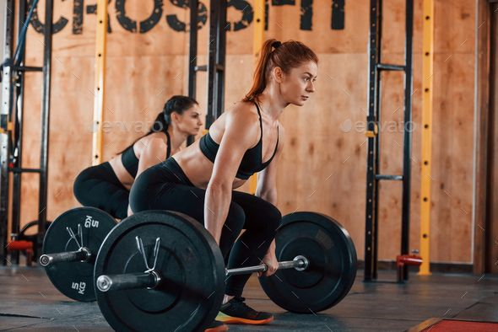
Introduction
Facilities
Services
Trainers
Membership
Navbar

Slide 3
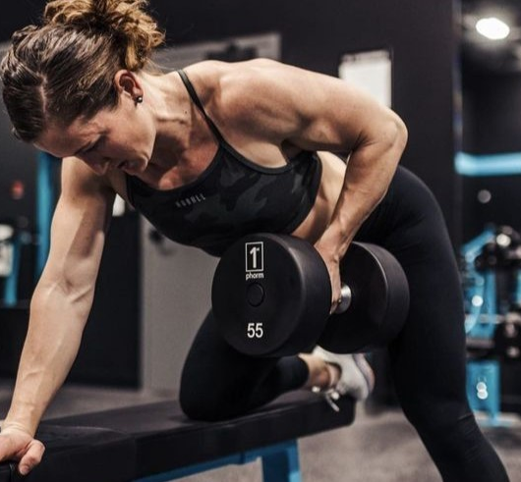
Introduction
With a well-designed website, users can easily access information about the gym's facilities, services, and training programs.
Moreover, the website can provide users with a platform to communicate with trainers, schedule workouts, and track their progress.

Slide 4
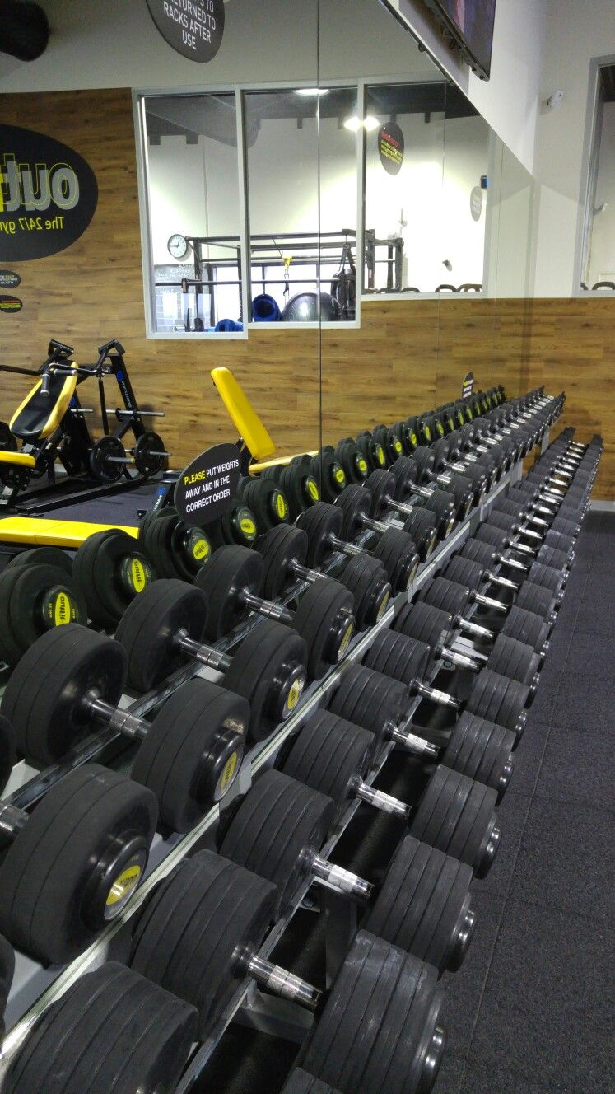
Facilities
In our gym there are all types of workout like :- yoga , Zumba , wight loss, Aerobic Classes , Body Building, Free weights , cardio …. And so on work out are there in our gym ….
You can take trail also will you contact us .There are 3 days for trail before join us

Slide 5
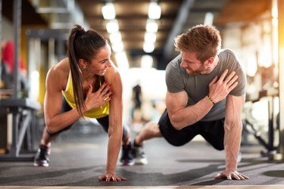
Services
Popular trainers
Multiple classis
Men and Women's changing rooms
Lockers System
Free Wi-Fi Zone
Complimentary Drinks

Slide 6
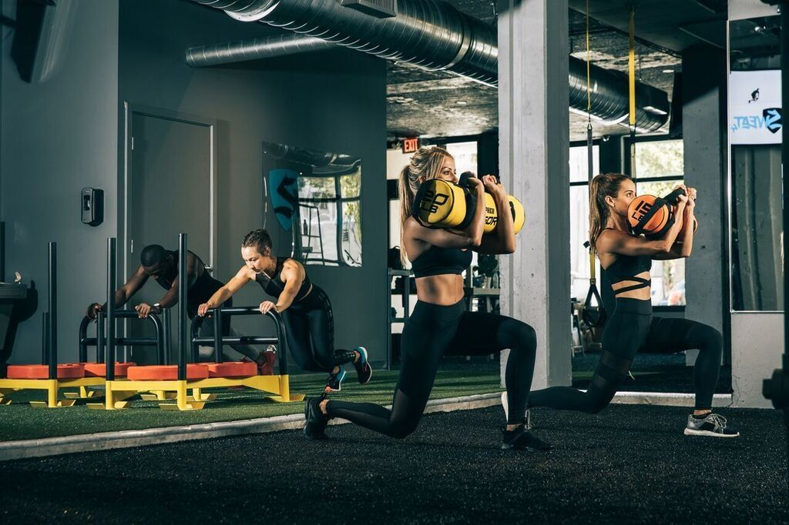
Membership plan
As you have see in our web page you can membership with us .
As amount are starting fom ₹7,000 to ₹20,000..
Basic :- 8month for 1 person
Standard
Standard :- 12 month for 1 person and 1 trainer will there ..
Premium :- 2 years for 2 person and 2 trainer will there..
Number of visits :- Unlimited

Slide 7
As you can see simple Navbar

Slide 8
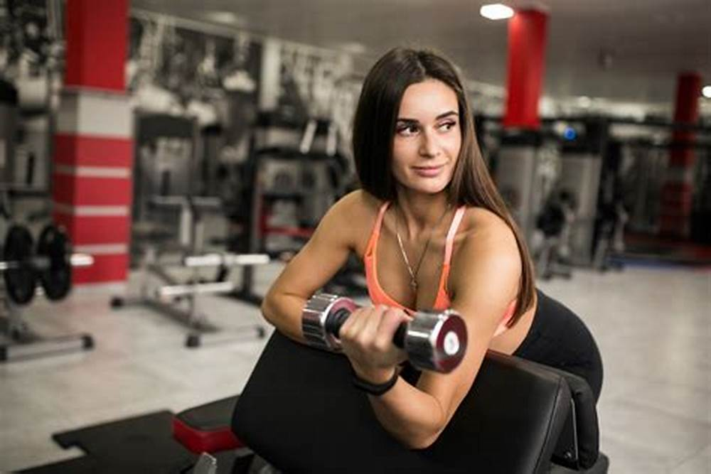
Different Types of Workouts You Can Do at the Gym
When it comes to working out at the gym, there are many different types of exercises you can do. One popular type of workout is cardio, which includes activities like running, cycling, and using the elliptical machine. Cardio workouts are great for improving your cardiovascular health and burning calories.

Slide 9
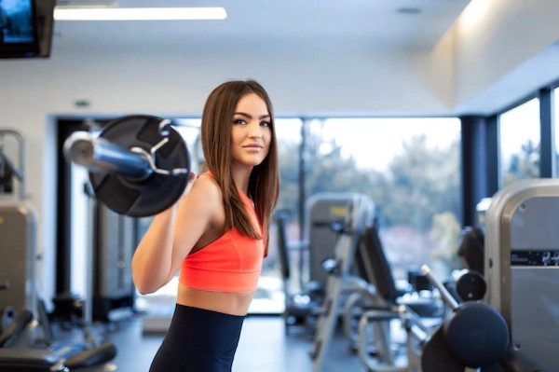
The Benefits of Going to the Gym
Going to the gym is not just about getting in shape, it has many other benefits as well. One of the biggest advantages of going to the gym is that it can help reduce stress and anxiety. Exercise releases endorphins which are natural mood boosters. Another benefit of going to the gym is that it can improve your sleep quality. Regular exercise can help regulate your sleep cycle and make it easier for you to fall asleep at night.

